Slide 1
Memory Management in OS
By
M. BABY ANUSHA,
ASST.PROF IN CSE DEPT.,
RGUKT,NUZVID

Slide 2
Introduction :
Memory is the important part of the computer that is used to store the data. Its management is critical to the computer system because the amount of main memory available in a computer system is very limited. At any time, many processes are competing for it.
Moreover, to increase performance, several processes are executed simultaneously. For this, we must keep several processes in the main memory, so it is even more important to manage them effectively.

Slide 3
Introduction :
Memory management is the functionality of an operating system which handles or manages primary memory and moves processes back and forth between main memory and disk during execution.
Memory management keeps track of each and every memory location, regardless of either it is allocated to some process or it is free.

Slide 4
Introduction :
Also, it checks how much memory is to be allocated to processes. It decides which process will get memory at what time.
It tracks whenever some memory gets freed or unallocated and correspondingly it updates the status.
To achieve a degree of multiprogramming and proper utilization of memory, memory management is important.

Slide 5
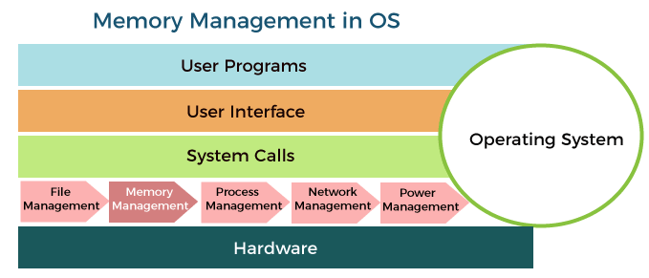

Slide 6
Need for Memory Management
Memory management technique is needed for the following reasons:
Allocate and de-allocate memory before and after process execution.
To keep track of used memory space by processes.
It helps to protect different processes from each other so that they do not interfere with each other's operations.

Slide 7
Need for Memory Management
It helps to allocate space to different application routines.
It allows you to check how much memory needs to be allocated to processes that decide which processor should get memory at what time.
It keeps the track of each memory location whether it is free or allocated.

Slide 8
Methods Involved in Memory Management :
Memory Management can be done intelligently by the Operating System:
The Memory management Techniques can be classified into following main categories:
Contiguous memory management schemes
Non-Contiguous memory management schemes

Slide 9
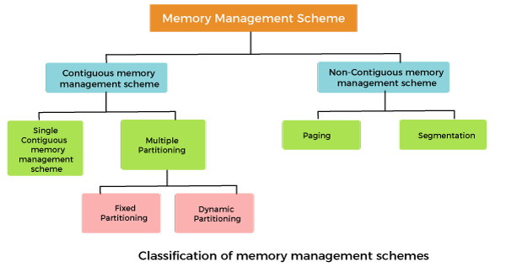

Slide 10
Contiguous Memory Allocation in Operating System

Slide 11
Single contiguous memory management schemes:
The Single contiguous memory management scheme is the simplest memory management scheme used in the earliest generation of computer systems.
In this scheme, the main memory is divided into two contiguous areas or partitions.
The operating systems reside permanently in one partition, generally at the lower memory, and the user process is loaded into the other partition.

Slide 12
Advantages of Single contiguous memory management schemes:
Simple to implement.
Easy to manage and design.
In a Single contiguous memory management scheme, once a process is loaded, it is given full processor's time, and no other processor will interrupt it.

Slide 13
Disadvantages of Single contiguous memory management schemes:
Wastage of memory space due to unused memory as the process is unlikely to use all the available memory space.
The CPU remains idle, waiting for the disk to load process into the main memory.
It can not be executed if the program is too large to fit the entire available main memory space.
It does not support multiprogramming, i.e., it cannot handle multiple programs simultaneously.

Slide 14
Multiple Partitioning:
The single Contiguous memory management scheme is inefficient as it limits computers to execute only one program at a time resulting in wastage in memory space and CPU time.
The problem of inefficient CPU use can be overcome using multiprogramming that allows more than one program to run concurrently.

Slide 15
Multiple Partitioning:
To switch between two processes, the operating systems need to load both processes into the main memory.
The operating system needs to divide the available main memory into multiple parts to load multiple processes into the main memory. Thus multiple processes can reside in the main memory simultaneously.

Slide 16
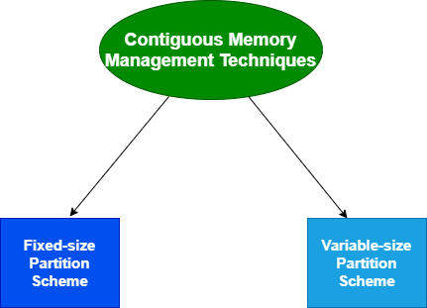
Multiple Partitioning:
The multiple partitioning schemes can be of two types:
Fixed Partitioning
Dynamic Partitioning

Slide 17
Fixed Partitioning :
The main memory is divided into several fixed-sized partitions in a fixed partition memory management scheme or static partitioning.
These partitions can be of the same size or different sizes. Each partition can hold a single process.

Slide 18
Fixed Partitioning :
The number of partitions determines the degree of multiprogramming, i.e., the maximum number of processes in memory.
These partitions are made at the time of system generation and remain fixed after that.

Slide 19
Fixed Partitioning :
Advantages of Fixed Partitioning memory management schemes:
Simple to implement.
Easy to manage and design.
Disadvantages of Fixed Partitioning memory management schemes:
This scheme suffers from internal fragmentation.
The number of partitions is specified at the time of system generation.

Slide 20
Dynamic Partitioning :
The dynamic partitioning was designed to overcome the problems of a fixed partitioning scheme.
In a dynamic partitioning scheme, each process occupies only as much memory as they require when loaded for processing.

Slide 21
Dynamic Partitioning :
Requested processes are allocated memory until the entire physical memory is exhausted or the remaining space is insufficient to hold the requesting process.
In this scheme the partitions used are of variable size, and the number of partitions is not defined at the system generation time.

Slide 22
Dynamic Partitioning :
Advantages of Dynamic Partitioning memory management schemes:
Simple to implement.
Easy to manage and design.
Disadvantages of Dynamic Partitioning memory management schemes:
This scheme also suffers from internal fragmentation.
The number of partitions is specified at the time of system segmentation.

Slide 23


